Slide 2
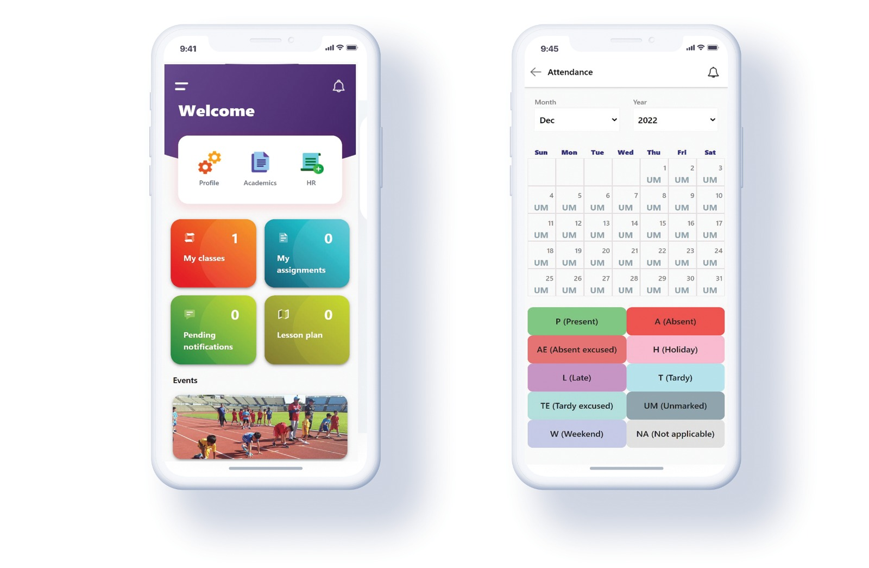
EduEgate : All-in-One School Management Software
EduEgate is an all-in-one solution for school management that helps to streamline all curricular and co-curricular activities.
A complete school management solution available in desktop, mobile and other devices which helps parents and students, generate reports and manage the database of the students.
The software is specially designed to tackle the common issues faced by schools i.e., administration, teacher management, generating reports and managing the database of the students.
You can run school without any concern by utilizing a highly customized school management software developed by a team of experts in the field.

Slide 3
EduEgate : All-in-One School Management Software
Parent App
Customized to send SMS about their child
Test marks, Attendance shared via the Parent App.
Teacher App
Apps for teachers to monitor, manage and record all required student information
Student Portal
Assignments, Timetables, Worksheets could be reviewd through this portal.
Student queries and complaints can be addressed.
Administrator Portal
Fee defaulters, Online fees tracking, Uniforms, canteen bookings, library could be monitored with all rights.

Slide 4
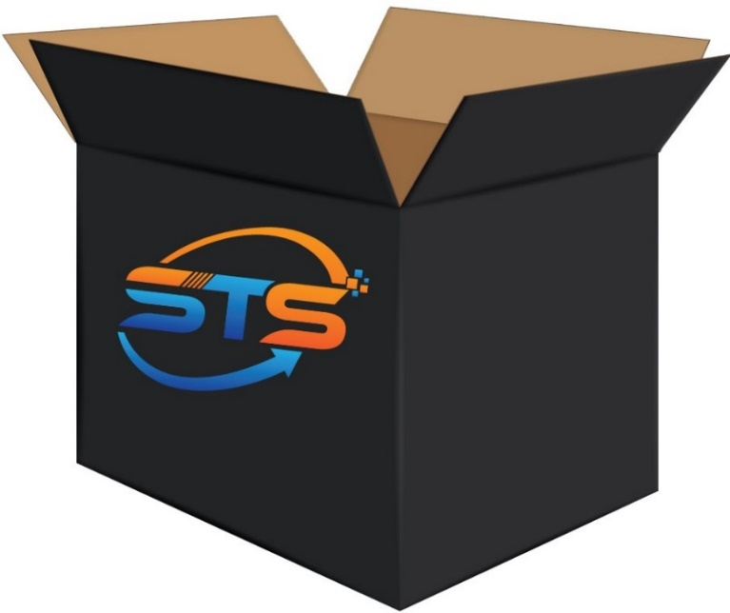
11
Admission Lead Management
Attendance Management
Modules
Student Analytics & Tracking
School Fees Management
HR & Payroll
Canteen Management
Finance & Accounting
Examination & Report card Module
Asset & Inventory Management
Student Transport Management
6
2
1
3
5
4
8
12
7
9
11
10
Library Management

Slide 5
Key Features of EduEgate
Efficient analysis of individual student data
Track student classroom performance
Automated yearly invoice generation
Track collections & defaulters with ease
Data safe & secure with our cloud-based software
Track Staff attendance and payout details Monthly/yearly

